Slide 1

Data reduction and Analysis with Mantid Current development and usage
Anders Markvardsen
STFC www.mantidproject.org

Slide 2
Project History
July 2007 Requirements & Design
April 2008 V 1.0 First instrument support
Feb 2010 V1.1 Support multiple techniques
April 2010 Collaboration with SNS & HFIR
Jan 2012 V2.0
Scientist validated results. VATES integration

Slide 3
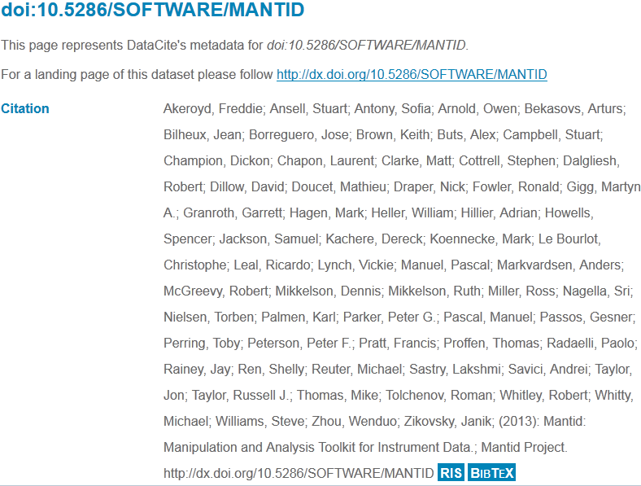
Project History

Slide 4

Project Goals
Goals
Consolidate the data reduction/analysis software for neutron/muon scattering without restricting the needs of the instrument scientists
Key requirement
Create a data reduction/analysis framework
not instrument or technique/dependent
Cross-platform
Windows, Linux, Mac
Easily extensible
Freely redistributable

Slide 5
Design Criteria
Separation of Data and Algorithms
Encapsulated “User Code” in specific places
Algorithms
Workspaces
Use of interfaces to allow generic use of components
Reuse of existing components
Careful memory management when handling large datasets

Slide 6

Architectural Design - Overview
Instrument log files
Python
Command line & Scripting interface
Mantid Framework
RAW data files
API
Algorithms
Workspaces
MantidPlot Graphing and analysis
NEXUS data files
User Defined
User Defined
DAE direct access
Future Instrument specific UI
Future Instrument specific UI

Slide 7
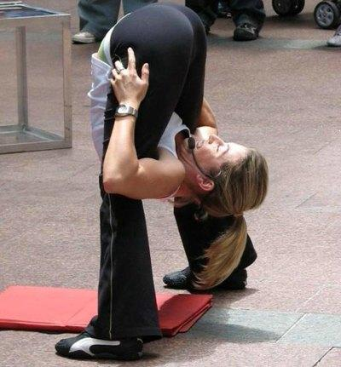
Framework flexibilty
Instrument independence
Virtual instrument defined
Loaded from xml definition
Location, rotation and shape of every pixel
Sample
Source
Technique independence
Algorithms
Unit Reduction and analysis steps
Workflow scripts / Algorithms
Chain algorithms to perform a reduction workflow

Slide 8
Plug in extensions
Algorithm Dialogs Custom Interfaces Custom Menus
Algorithms
Unit Conversions
Fit Functions Cost Models Constraints Minimizer
Workspaces
Archive Searching LiveData Listeners Data Catalogs
GUI
Framework
(Framework) Utility

Slide 9
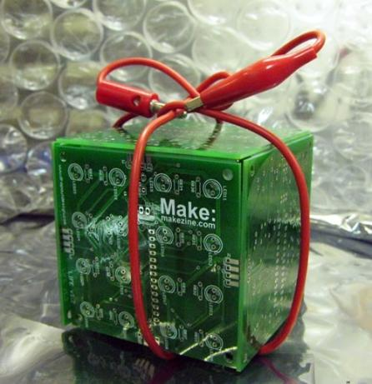
Open Source
GPL v3
Free to use
Source code openly available
Good basis for collaboration
Sharing benefits to wider community

Slide 10
Project decision makers
Instrument scientists/users
PMB/PM
Developers/TSC

Slide 11
A few examples of how Mantid is used with other software
SANS
Mantid used for data reduction
Sasview used for data analysis
Powder diffraction
Mantid used for data reduction
Fullprof/GSAS/other used for data analysis

Slide 12
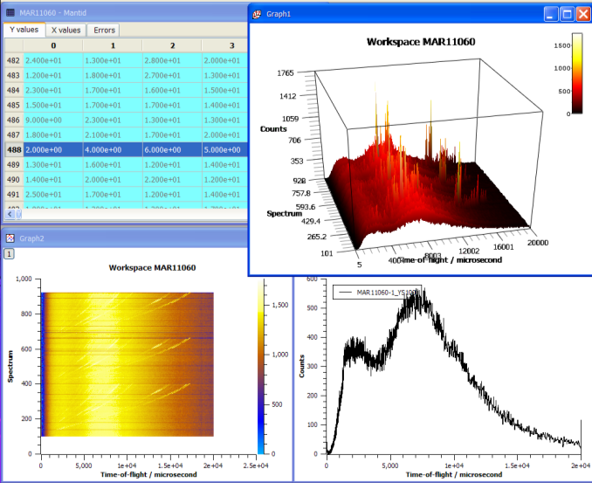
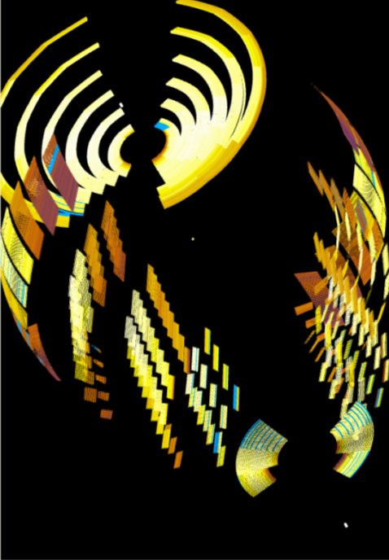
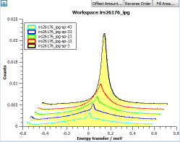
What can we do - Visualization

Slide 13
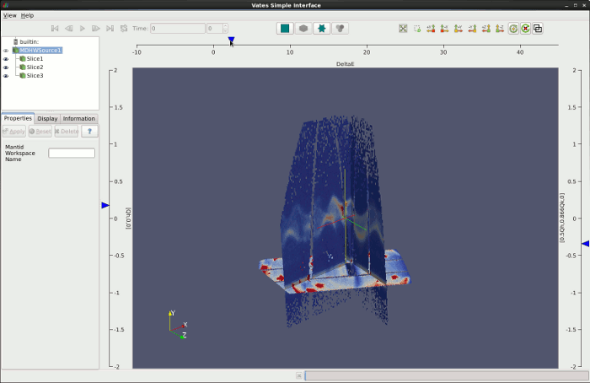
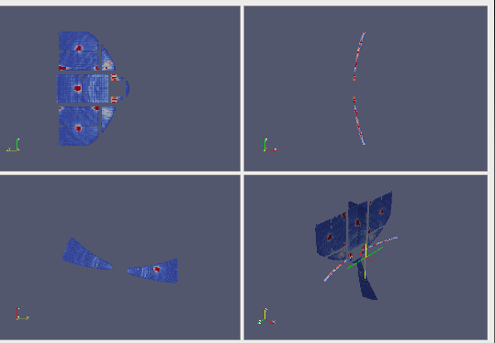
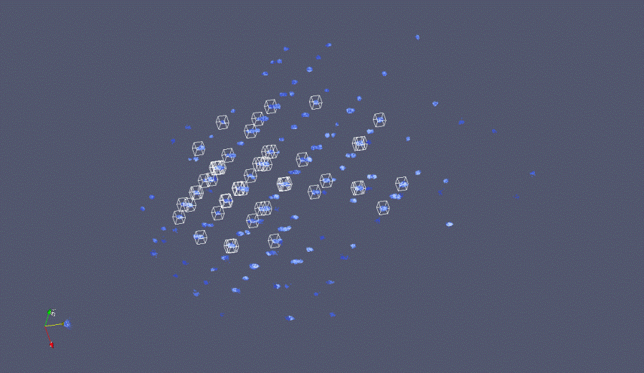
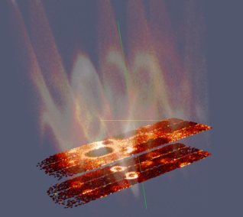
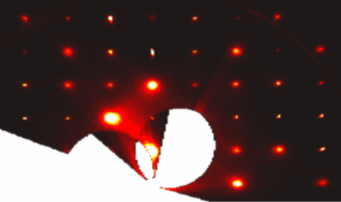
What can we do - Visualization

Slide 14
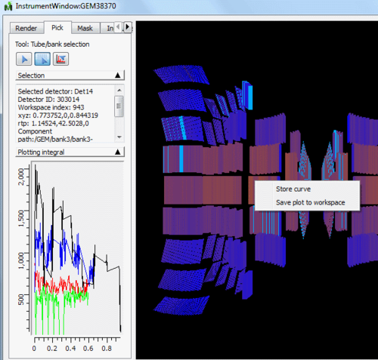
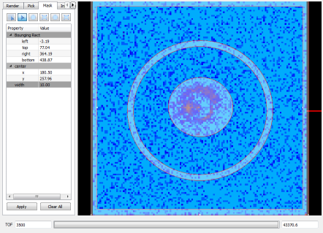
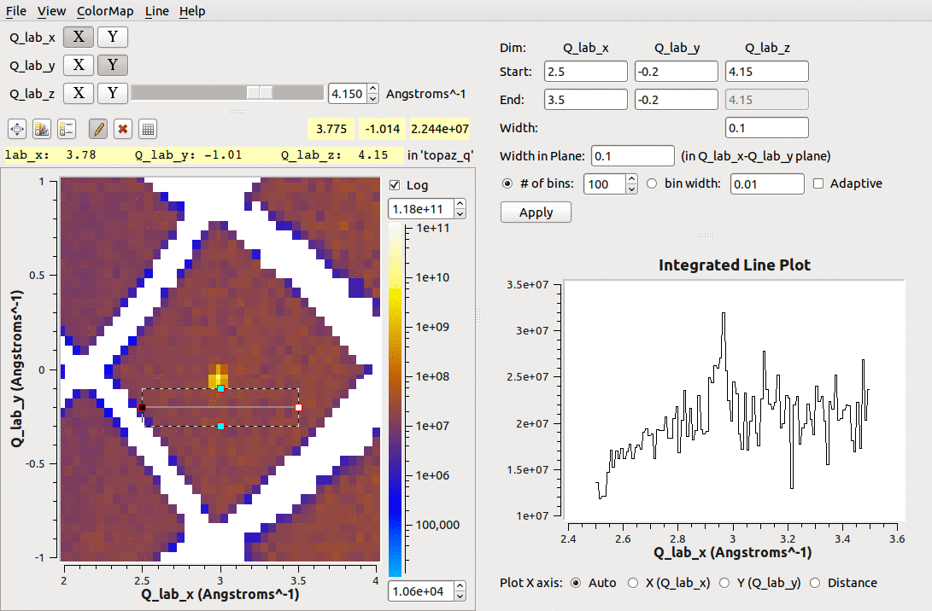
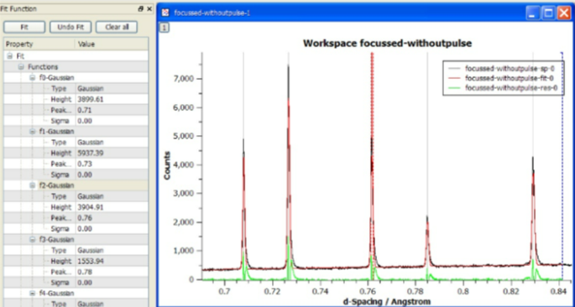
What we can do - Tools

Slide 15
What we can do - Algorithms
~600
Arithmetic
Correction Functions
Absorption
Background
Efficiency
Technique
Single Crystal
Inelastic
SANS
Powder diffraction
Data handling
Diagnostics
Event Filtering
Optimization
Transforms
Masking
Grouping
Smoothing
Unit conversions

Slide 16
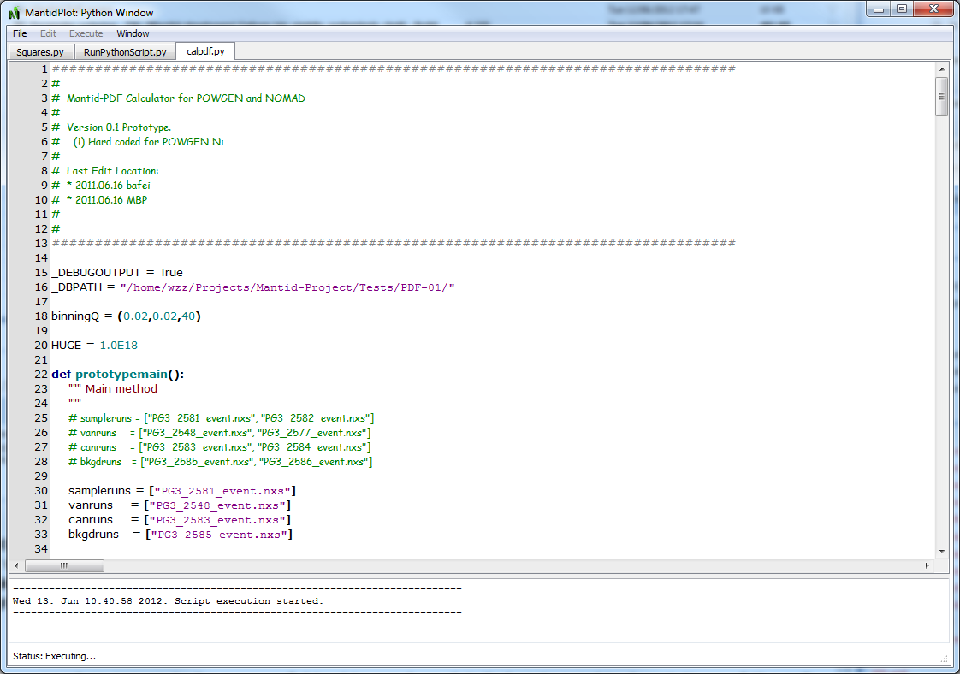
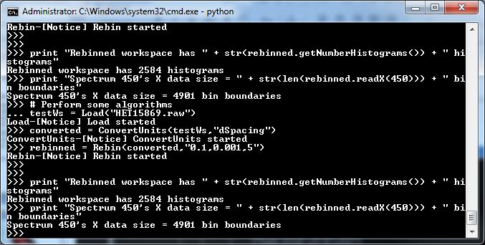
What we can do - Scripting
Python Control
Within Mantidplot
Pure Python scripts
Integrated numPy
Automated reduction

Slide 17
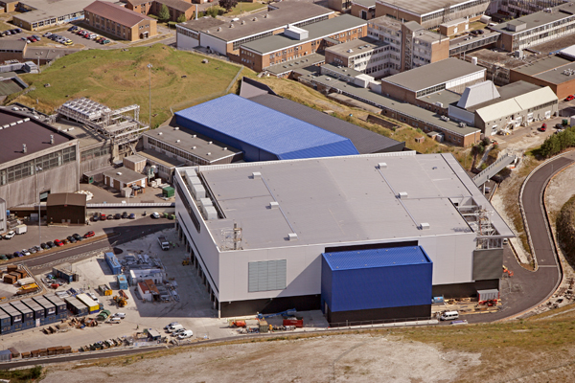
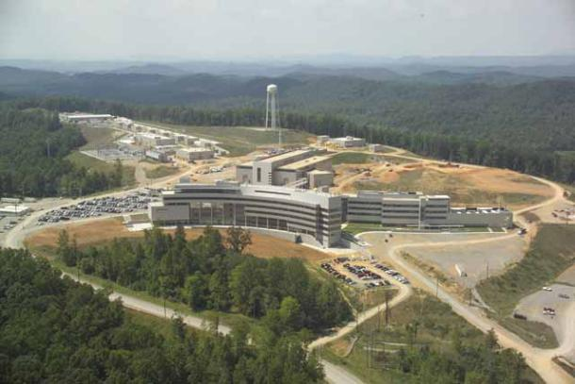
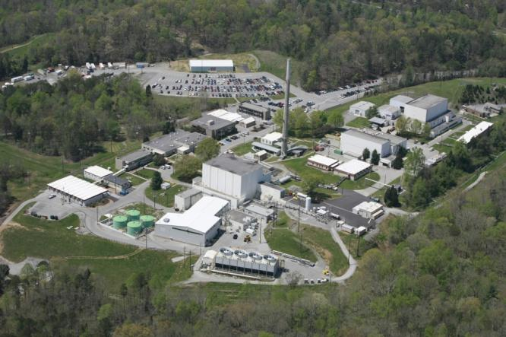
ISIS - SNS & HFIR collaboration

Slide 18
SNS Collaboration Timeline
March 2009
Oct 2009
Jan 2010
Apr 2010
May 2010
Aug 2010
Week with the development team
Discussions with several scientist users
Future plans
Areas of common interest
Initial meeting & discussions
ICNS 2009
Due Diligence visit
Go / No Go decision
Memorandum of Understanding
Joint development begins
Initial SNS & HFIR support

Slide 19
Project Organisation
ISIS
SNS/HIFR
Users
Scientific Steering Committee
Development Team
Users
Scientific Steering Committee
Development Team

Slide 20
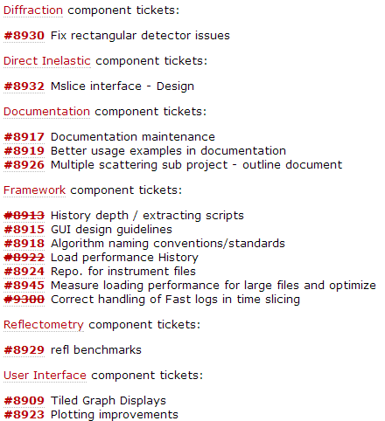
SSC headline tickets for 3.2
http://trac.mantidproject.org/mantid/roadmap

Slide 21
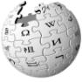
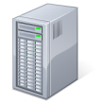
Continuous Integration Environment
Deploy to
Download site
Mantid Project Wiki
GitHub Repository
Automated System test
Build + unit test
-Linux (RHE & Ubuntu)
-Mac OSX
-Windows 32
-Windows 64
trac Issue
tracking
system
Developers

Slide 22
Communication
Face to face meetings
PMB 2-3yr
Developer workshops
Yearly SSC
Visits from other facilities
Communication channels
Developer email list
Skype
Phone
Screen sharing
Video conferencing

Slide 23
ISIS -> SNS
Robust framework
Common development structure
Multithreaded performance
Documentation and training
Automated build, test and deployment
Algorithms
Over 150 algorithms already developed
Development support
help

Slide 24
SNS -> ISIS
Improvements to build process
Cmake, Hudson
Event Filtering and data analysis
Improved python code framework
Autoreduction system
New file format support
NxSPE
Event Nexus

Slide 25
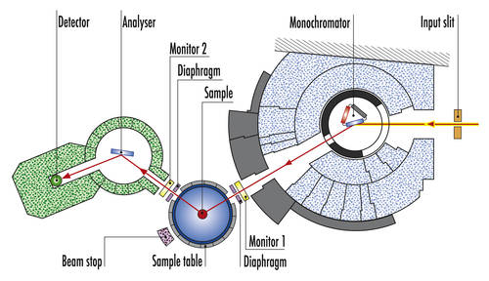
ILL challenges
No TOF (for some instruments)
1 less dimension - Smaller datasets
Different reduction workflows
New reduction steps
Moving Instrument Components
Dynamic ‘virtual’ detectors
Periods
Similar to reflectometers
MD workspaces

Slide 26
Other facilities have contributed
ILL
ESS
PSI
ANSTO
…etc

Slide 27
Lessons Learned
Developer documentation
Need to rapidly induct several new developers
Will not be good enough
Communication
Has to be encouraged
Will take some time
Personal relationships
Are key to working together in a team
High level support is essential
No two facilities are the same
Archive structure
Information catalog

Slide 28
Lessons Learned
Minor irritations
You may have learned to live with them
Will be much more irritating to new developers
Make use of this enthusiasm
Development Environments
Will differ across facilities
Set up can be painful
Don’t let issues linger
Design
Consider implications
Design for flexibility

